Slide 1

Computer Programming for Engineers
Week 11 Lecture 2
Nov. 10, 2022
Lecturer: Mohammad Mahdi Javidan
College of Engineering, Sungkyunkwan University
Fall Semester 2022

Slide 2

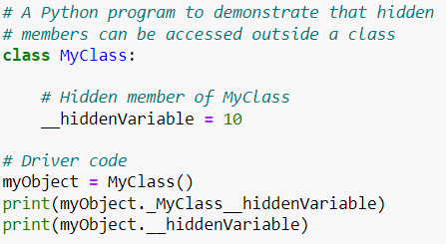
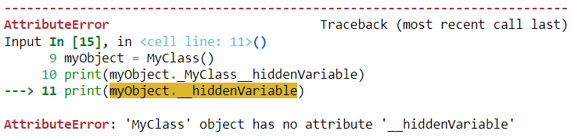
Private Variables
In Python nothing is 100% private!
A syntax for accessing private variables
College of Engineering, Sungkyunkwan University

Slide 3
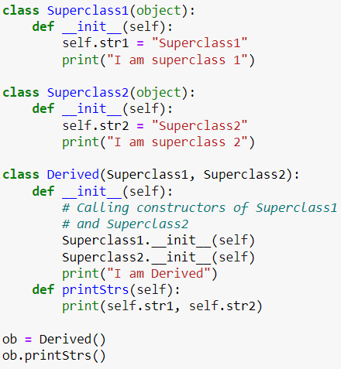

Multiple Inheritance
The Derived class is inherited from both Superclass1 and Superclass2
To have the same attributes constructors of the superclasses have to be called
College of Engineering, Sungkyunkwan University

Slide 4
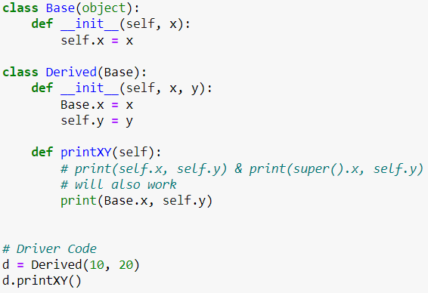

Parent Members
College of Engineering, Sungkyunkwan University

Slide 5
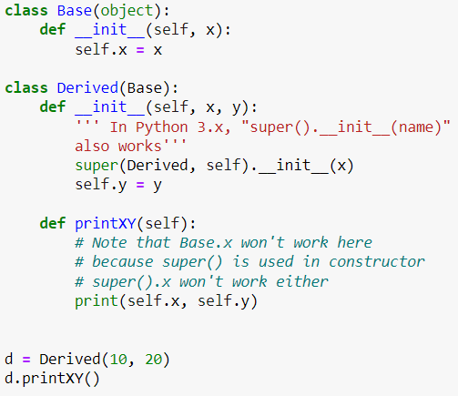
Parent Members
Triple quotes for long comments in spread in several lines
College of Engineering, Sungkyunkwan University

Slide 6
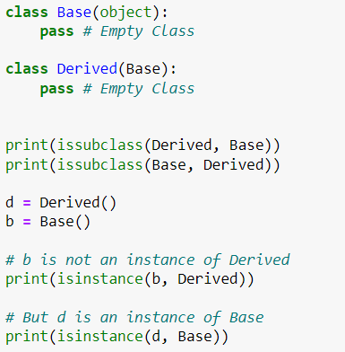

Subclass and Instance
You can recall isinstance from type checking
College of Engineering, Sungkyunkwan University

Slide 7
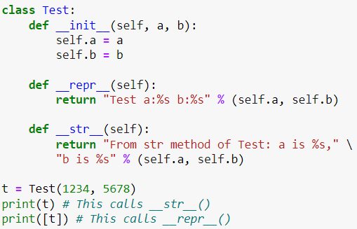

Printing an Object
Reserved methods __str__ and __repr__
College of Engineering, Sungkyunkwan University

Slide 8
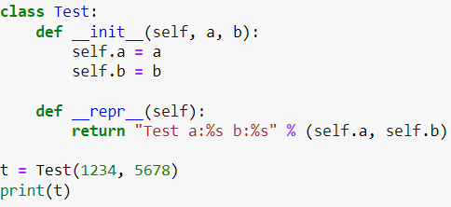

Printing an Object
When __str__ is not defined, Python uses __repr__
College of Engineering, Sungkyunkwan University

Slide 9
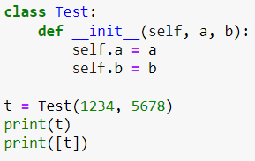

Printing an Object
If __str__ and __repr__ are not defined
College of Engineering, Sungkyunkwan University

Slide 10
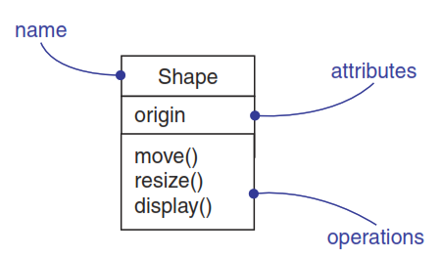
Unified Modeling Language (UML)
a general-purpose, developmental modeling language in the field of software engineering
Classes
https://en.wikipedia.org/wiki/Unified_Modeling_Language
G. Booch, J. Rumbaugh, I. Jacobson “The Unified Modeling Language User Guide 2nd Edition”.
College of Engineering, Sungkyunkwan University

Slide 11
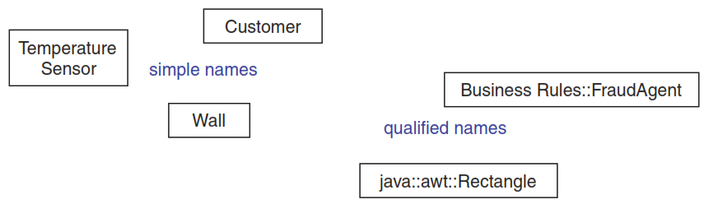
Name of a Class
Simple and qualified names
College of Engineering, Sungkyunkwan University

Slide 12
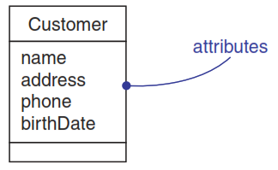
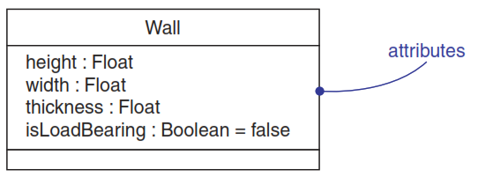
Attributes
Attributes
Attributes, types, and default values
College of Engineering, Sungkyunkwan University

Slide 13
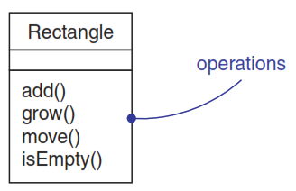
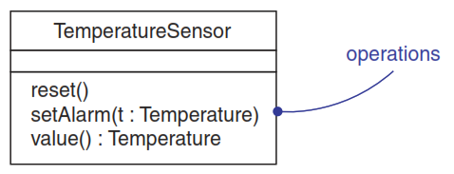
Operations
Operations
Operations and their Signatures
College of Engineering, Sungkyunkwan University

Slide 14
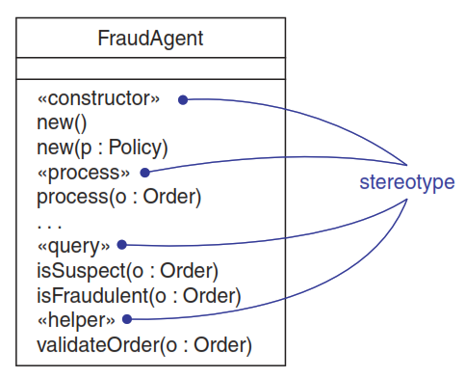
Organizing Attributes and Operations
An ellipsis showing there are more properties
Stereotypes for class features
College of Engineering, Sungkyunkwan University

Slide 15
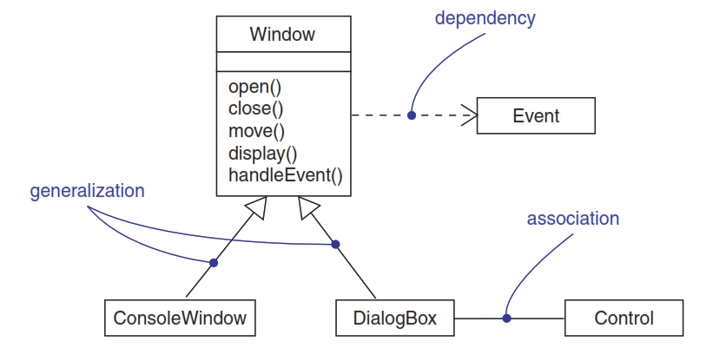
Relationships
Dependency: a relationship that states that one thing (class Window) uses the information and services of another thing (class Event), but not necessarily the reverse. (Reference to another class)
College of Engineering, Sungkyunkwan University

Slide 16
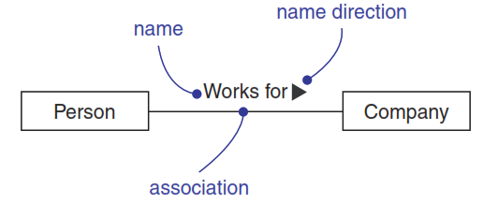
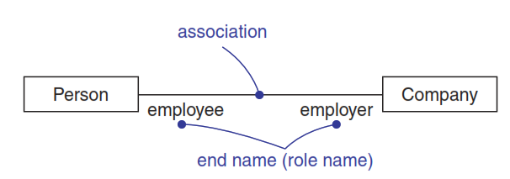
Relationships
Operations
Association end names (role names)
Association: a structural relationship that specifies that objects of one thing are connected to objects of another:
Teacher X teaches Student Y
College of Engineering, Sungkyunkwan University

Slide 17
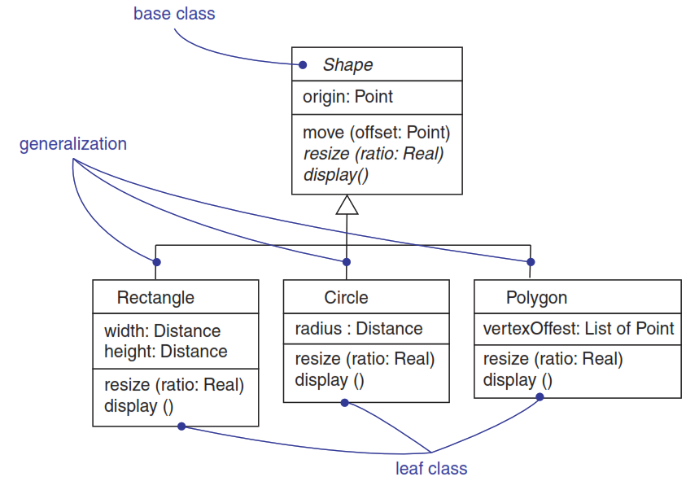
Relationships
Generalization: a relationship between a general kind of thing (called the superclass or parent) and a more specific kind of thing (called the subclass or child). Generalization is sometimes called an “is-a-kind-of ”.
College of Engineering, Sungkyunkwan University

Slide 18
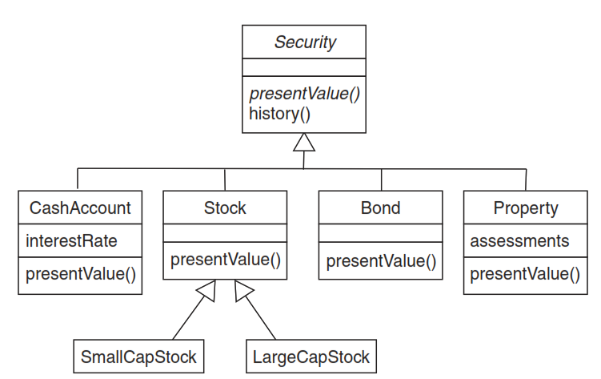
Relationships
Abstract: a class with an operation prototype, but not implementation. It must be implemented by some method at a lower level of abstraction. In fact, as the figure shows, all four of the immediate children of Security are nonabstract and must each provide a concrete implementation of the operation presentValue
College of Engineering, Sungkyunkwan University

Slide 19
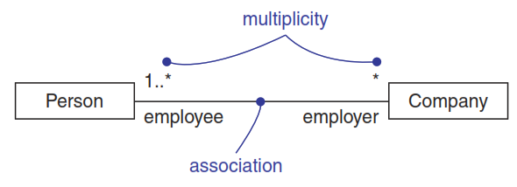
Relationships
Multiplicity: it states how many objects may be connected across an instance of an association. You can show a multiplicity of exactly one (1), zero or one (0..1), many (0..*), or one or more (1..*).
College of Engineering, Sungkyunkwan University

Slide 20
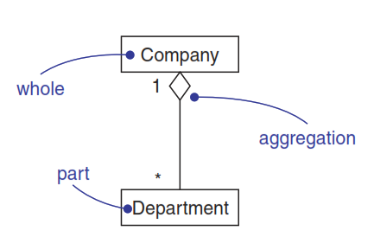
Relationships
Aggregation: one class represents a larger thing (the “whole”), which consists of smaller things (the “parts”). This kind of relationship is called aggregation, which represents a “has-a” relationship.
College of Engineering, Sungkyunkwan University

Slide 21
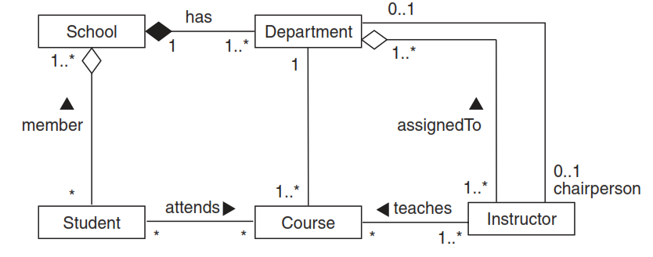
Relationships
Composition: a special type of aggregation which indicates strong ownership. (The one will never exist indepently)
College of Engineering, Sungkyunkwan University

Slide 22
Relationships
A school has zero or more students.
Each student may be a registered member of one or more schools.
A school has one or more departments.
Each department belongs to exactly one school.
School is a whole and that Student and Department are some of its parts.
It is seen which one is organizationally superior to the other.
Students and departments don’t really stand alone.
There are two associations between Department and Instructor. One specifies that every instructor is assigned to one or more departments and that each department has one or more instructors.
College of Engineering, Sungkyunkwan University

